Slide 1

Employee Attrition Analysis
SHAIK SHEERU ALI MOULALI
UNID: UM/IP/1947
Position: Data Analyst Intern

Slide 2
Introduction
Attrition: It refers to the gradual reduction or decrease in the number of employees or participants in a company, organization, or group over time. It is often used to describe the natural process of individuals leaving or exiting a workforce for various reasons. Attrition can occur for both voluntary and involuntary reasons, and it can impact an organization in several ways.
Types of Attrition:
Voluntary Resignation
Retirement
Career Change
Health or Personal Issues
Layoffs or Downsizing
Disengagement or Dissatisfaction
Work-Life Balance
Personal Development

Slide 3
Attributes of Employee Attrition Dataset
1. Employee ID, 2. Age, 3. Attrition, 4. Business Travel,
5. Department, 6. Distance From Home, 7. Education, 8. Education Field,
9. Employee Count, 10. Gender, 11. Total Working Years, 12. Training Times Last Year,
13. Years At Company, 14. Years Since Last Promotion, 15. Years With Current Manager, 16. Environment Satisfaction,
17. Job Satisfaction, 18. Work-Life Balance, 19. Job Involvement, 20. Performance Rating.

Slide 4
Main KPIs:
Employee Count = 1151
Attrition Count = (Yes = 153, No = 998)
Attrition Rate = 13.29%
Active Employee = 998

Slide 5
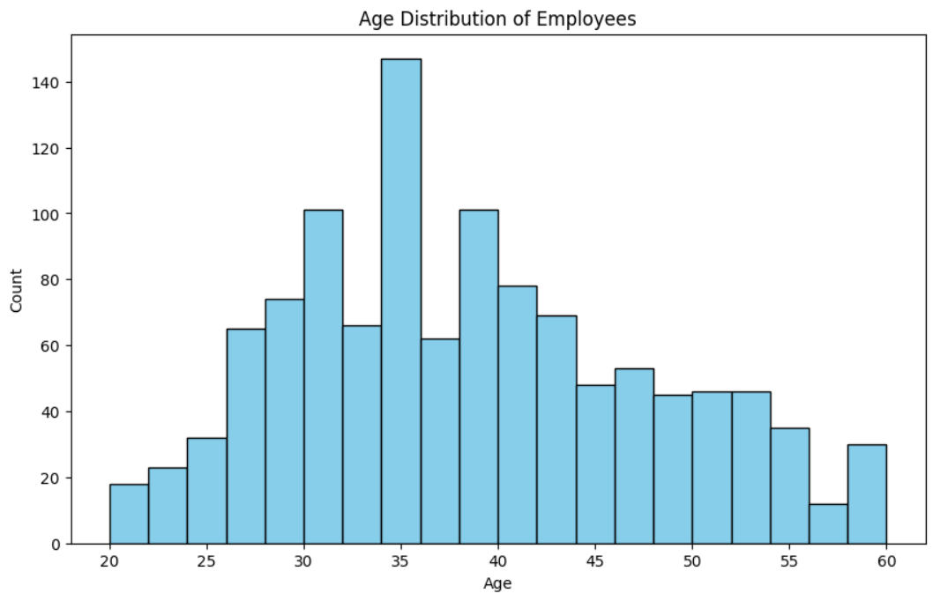
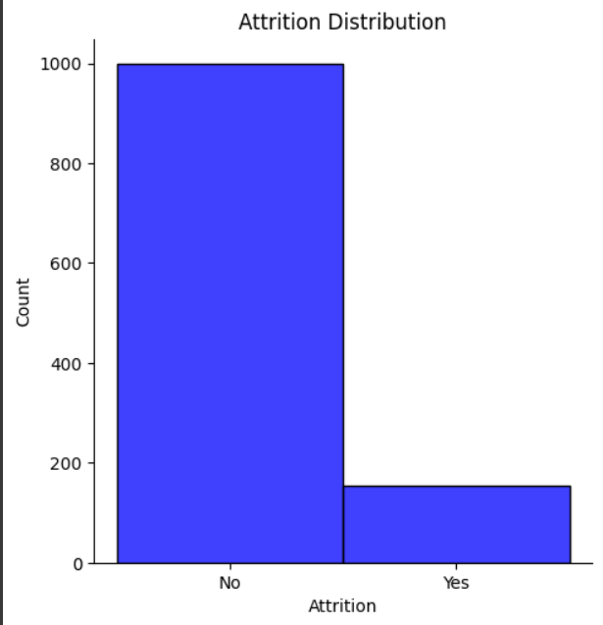
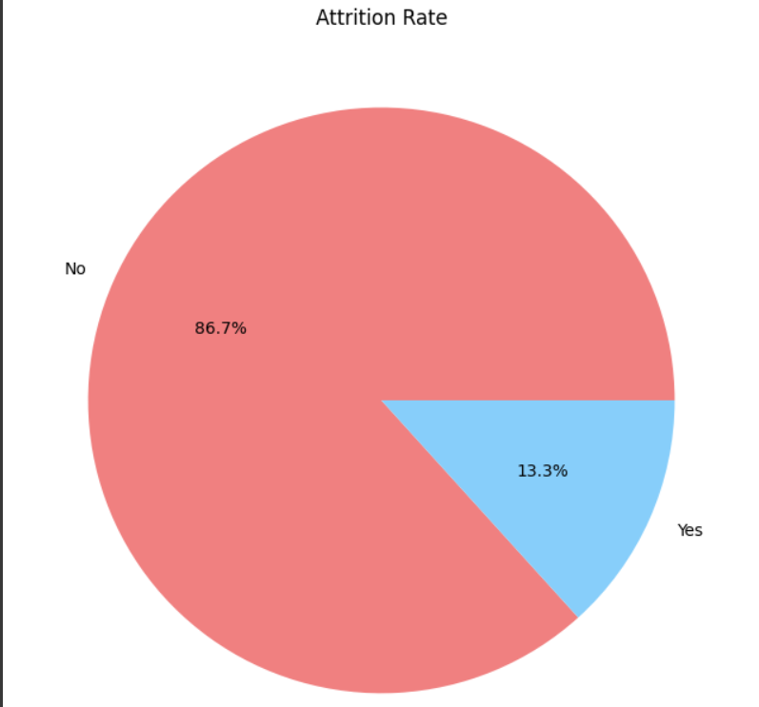
Worksheets

Slide 6
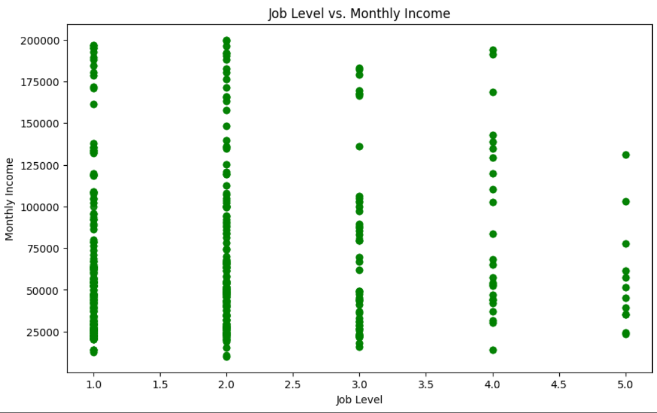
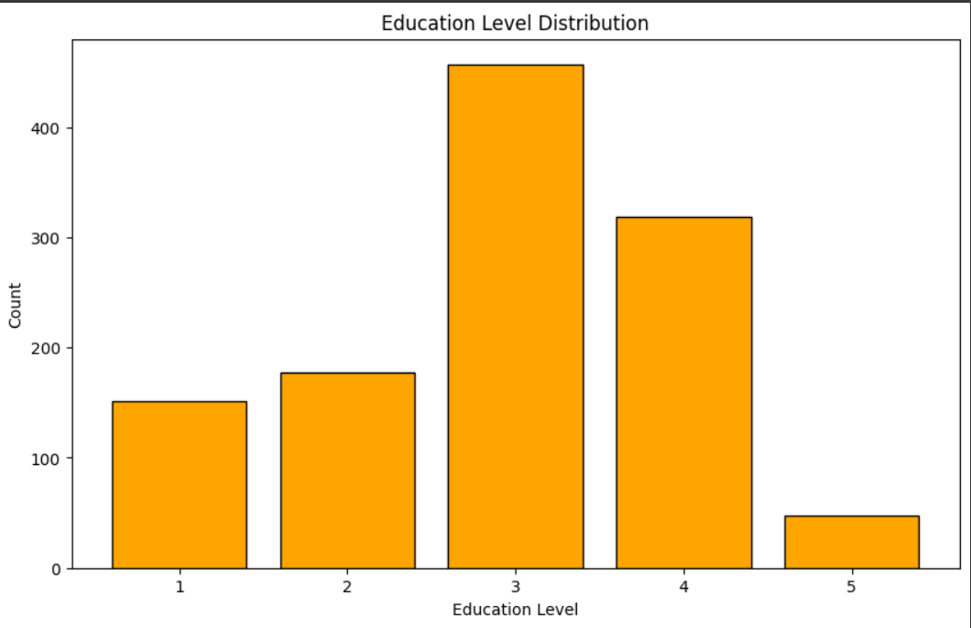
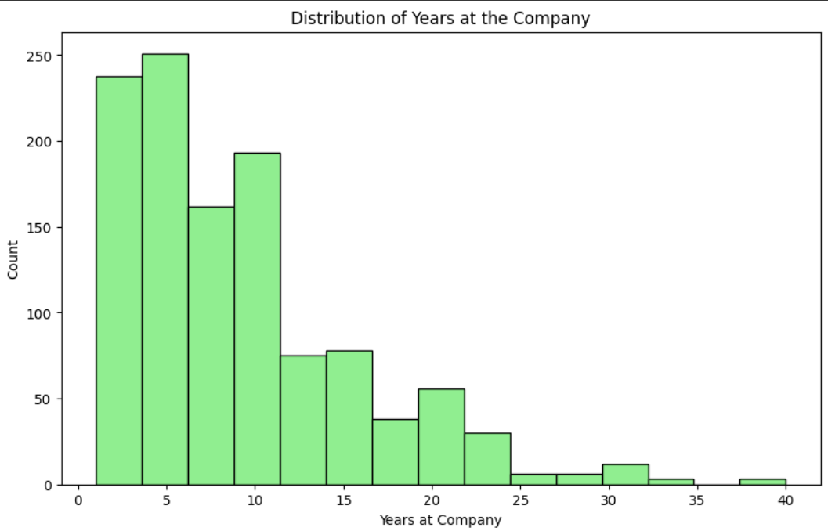
Worksheets

Slide 7
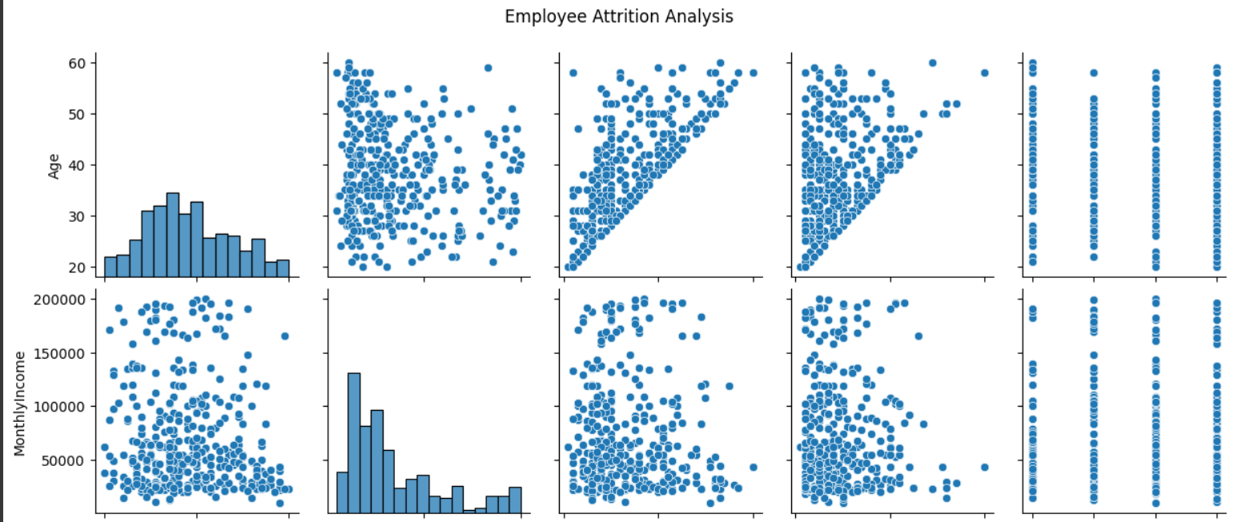
Worksheets:

Slide 8
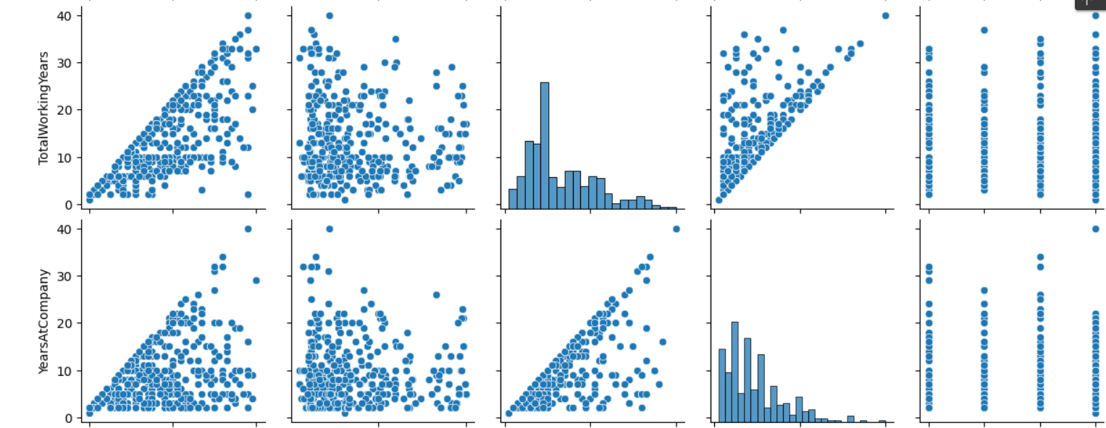
Worksheets:

Slide 9
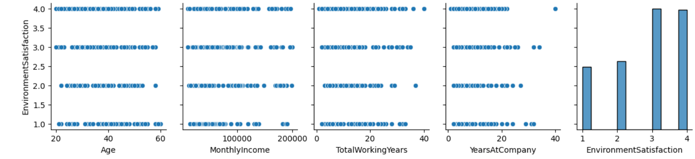
Worksheets:

Slide 10
thank you
GitHub Link: https://github.com/ShaikSheeru2001/Project_8_Employee_Attrition_Analysis

